Slide 1
ESC guidelines for management of patients with AF
Focus on OACs for stroke prevention in AF
February 2021

Slide 2
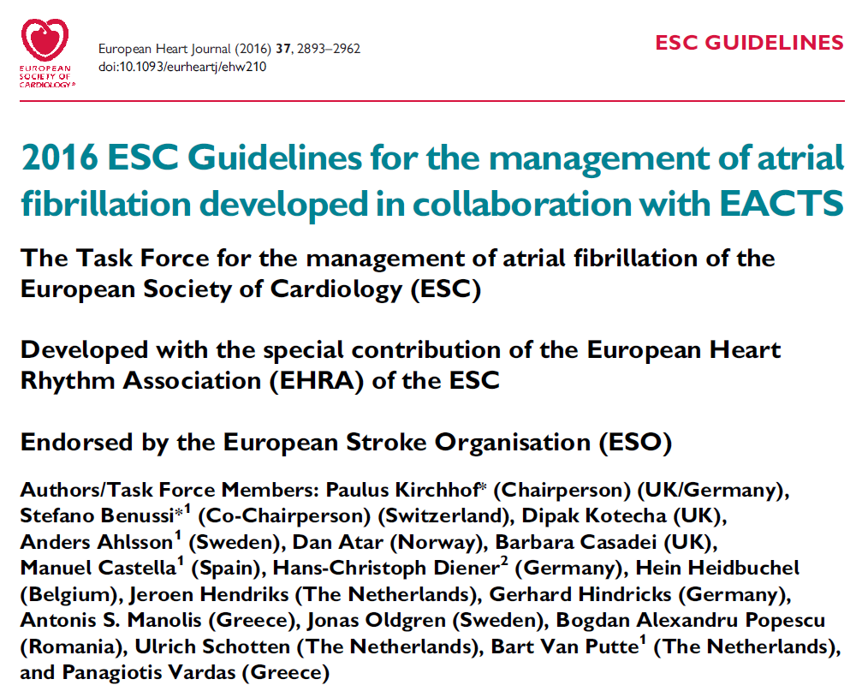
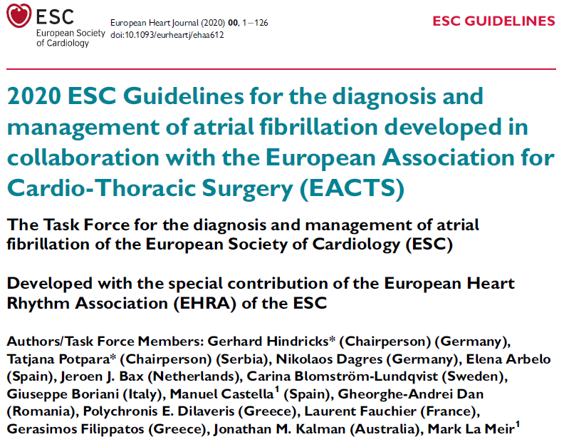
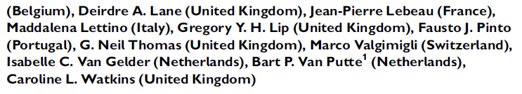
Updated European Society of Cardiology (ESC) guidelines on the diagnosis and management of AF are available
2016
2020
AIM
To further improve the structured management of AF patients,
promote patient values, and improve patient outcomes

Slide 3
Contents of this deck and how to use it
ESC
An overview of what is new or updated in the ESC 2020 guidelines is provided
for the following topics:
Epidemiology, structured characterization, and treatment of AF
Stroke prevention in AF
Stroke prevention in patients with AF undergoing procedures
Reversal of oral anticoagulants in emergency scenarios
The relevant sections of the guideline publications are indicated for more detailed information
The key dabigatran RCTs are stated for each topic, along with links to key data in the appendix
An appraisal of what is favourable and what is missing in the guidelines with respect to dabigatran data is provided, which should help manage questions on these topics
Some sections are colour coded for easy navigation
RCT
!
When you see this symbol, please read the slide notes page for additional information relating to the content of the slide
When you see this symbol, please view the slide in slideshow mode. Clicking the link will bring you to additional information in the Appendix
Press this symbol to go back to the original slide
i
⧫
RCT, randomized controlled trial

Slide 4
Important information
The primary purpose of this slide deck is to provide a resource for internal medical affairs and MSL training regarding the updated ESC guidelines for management of patients with AF
To help facilitate learning, each time a guideline recommendation is shown there is a link to direct the reader to the corresponding RCT data for dabigatran
In addition, key aspects of the guidelines are evaluated to provide internal personnel with important points to raise when discussing these data with HCPs
Slide 41 contains information on other internal resources where you can access further information on RCTs with dabigatran and FXa inhibitors
Should you use this deck for purposes other than internal training, please remember that you must follow your local compliance regulations and the product labels in your country.
HCP, healthcare professional; RCT, randomized controlled trial

Slide 5

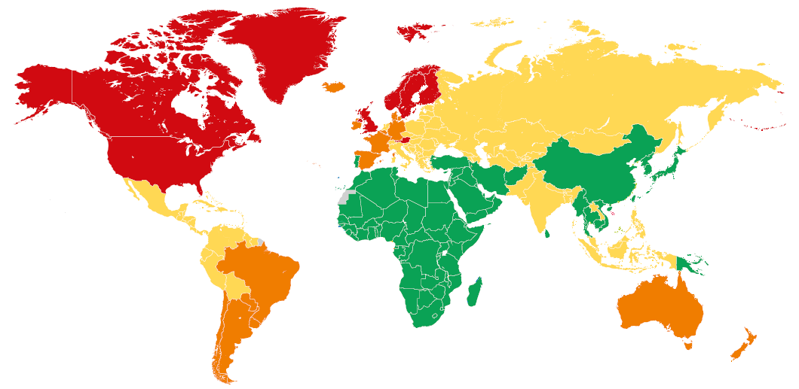
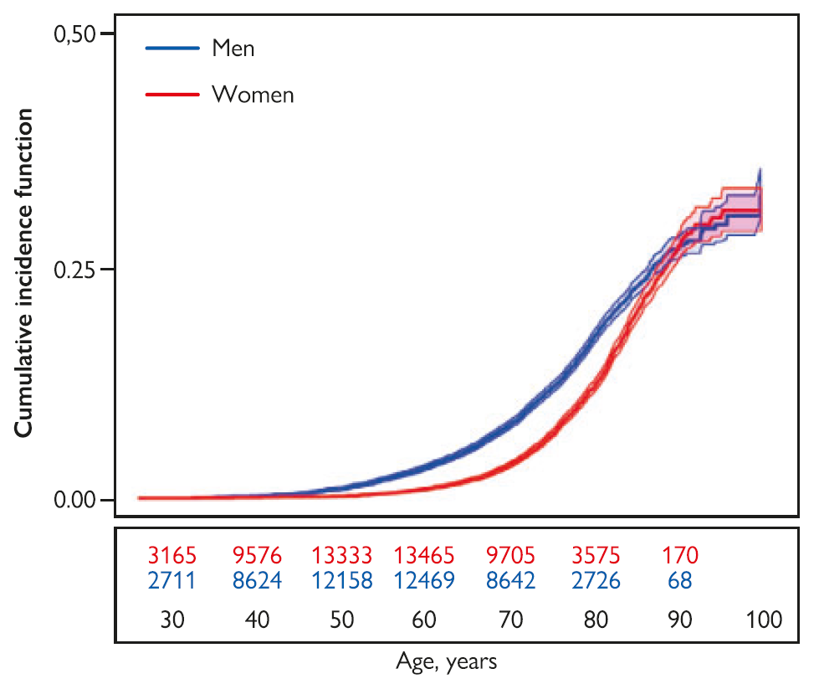
AF is associated with substantial morbidity and mortality, and significant socio-economic costs (1/2)
Global prevalence of AF
(globally, 43.6 million individuals had prevalent AF/atrial flutter in 2016)
Lifetime risk for AF
1 in 3 individuals
AF is more common in males
Cumulative incidence curves and 95% CIs for AF in women and men with death as a competing risk
of European ancestry at index age of 55 years 37.0% (34.3–39.6%)
<600
Age-standardized global prevalence rates of AF per 100 000
600–699
700–899
>900
Hindricks et al. Eur Heart J 2020; doi:10.1093/eurheartj/ehaa612
Notes:
The current estimated prevalence of AF in adults is between 2 and 4%, and a 2.3-fold rise is expected, owing to extended longevity in the general population and intensifying search for undiagnosed AF. The age-adjusted incidence, prevalence, and lifetime risk of AF are lower in women vs men and in non-Caucasian vs Caucasian cohorts. A previous lifetime AF risk estimate of 1 in 4 individuals was recently revised to 1 in 3 individuals of European ancestry at index age of 55 years.
Reference
Hindricks et al. Eur Heart J 2020; doi:10.1093/eurheartj/ehaa612

Slide 6
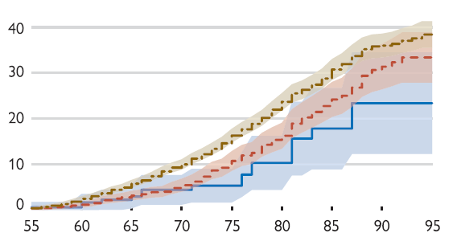
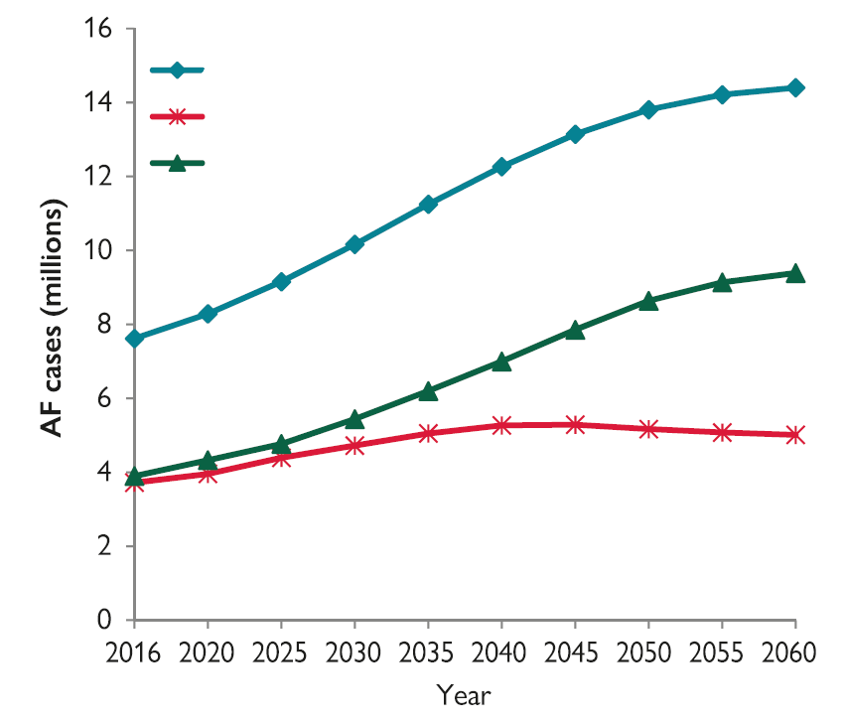

AF is associated with substantial morbidity and mortality, and significant socio-economic costs (2/2)
Projected increase in AF prevalence among elderly in EU 2016–2060
Lifetime risk of AF increases with increasing risk factor burden*
Total 65+ years
65–79 years
80+ years
Cumulative risk of AF (%)
Age (years)
Risk profile
Optimal: all risk factors are negative or within the normal range
Borderline: no elevated risk factors but >1 borderline risk factor
Elevated: >1 elevated risk factor
Optimal 23.4% (12.8–34.5%)
Borderline 33.4% (27.9–38.9%)
Elevated 38.4% (35.5–41.4%)
*Smoking, alcohol consumption, body mass index, BP, diabetes mellitus (type 1 or 2), and history of myocardial infarction or heart failure
Hindricks et al. Eur Heart J 2020; doi:10.1093/eurheartj/ehaa612

Slide 7
There are many risk factors for incident AF
Coronary artery disease
Vascular disease (subclinical atherosclerosis)
Heart failure
Acute illness, surgery
Valve disease
Physical
inactivity/intense activity
Ageing
(Borderline) Hypertension
Lipid profile
Genetics
AF
Ethnicity
(Pre-) Diabetes
Alcohol consumption
Male sex
Chronic kidney disease
Smoking
Inflammatory diseases
Obesity
COPD
Obstructive sleep apnoea
Increasing age is a prominent AF risk factor, but increasing burden of comorbidities, including hypertension and heart failure, is also important
COPD, chronic obstructive pulmonary disease
Hindricks et al. Eur Heart J 2020; doi:10.1093/eurheartj/ehaa612
Notes:
Modifiable risk factors are potent contributors to AF development and progression. The AF lifetime risk depends on age, genetic, and (sub)clinical factors. The observed impact of clinical risk factor burden/multiple comorbidity on AF risk suggests that an early intervention and modifiable risk factor control could reduce incident AF.
Reference
Hindricks et al. Eur Heart J 2020; doi:10.1093/eurheartj/ehaa612

Slide 8

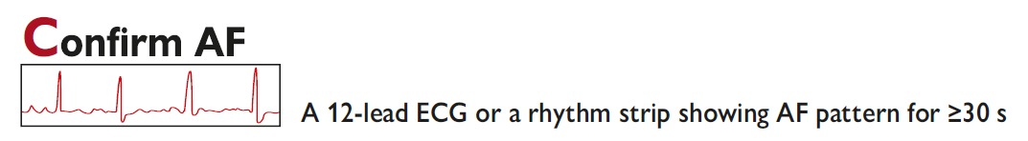
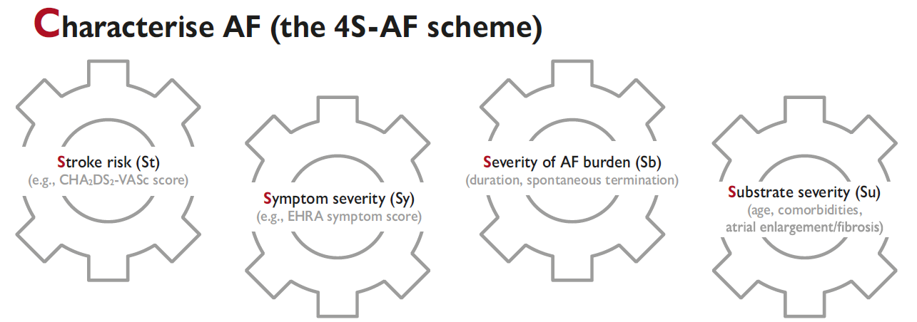
AF management includes structured characterization and a Better Care (ABC) approach (1/2)
EHRA, European Heart Rhythm Association
Hindricks et al. Eur Heart J 2020; doi:10.1093/eurheartj/ehaa612
Notes:
A paradigm shift from classification towards a structured characterization of AF, addressing specific domains with treatment and prognostic implications, has been recently proposed. This 4S-AF scheme aims to streamline the assessment of AF patients at any healthcare level, thus facilitating communication among physicians, treatment decision-making, and optimal management of AF patients, and should become a standard in clinical practice when reporting an AF case.
The proposed scheme includes four AF-related domains.
Stroke risk:
Truly low risk of stroke – Yes/No
Symptom severity:
Asymptomatic/mildly symptomatic
Moderate
Severe or disabling
Severity of AF burden:
Spontaneously terminating
AF duration and density of episodes per unit of time
Substrate severity:
Comorbidities/CV risk factors
Atrial cardiomyopathy (atrial enlargement/dysfunction/fibrosis)
Reference
Hindricks et al. Eur Heart J 2020; doi:10.1093/eurheartj/ehaa612

Slide 9
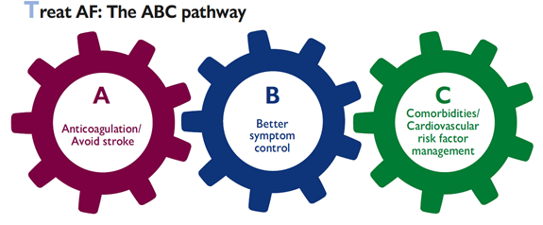
AF management includes structured characterization and a Better Care (ABC) approach (2/2)
1. Identify low-risk patients CHA₂DS₂-VASc 0(m), 1(f)
2. Offer stroke prevention if CHA₂DS₂-VASc ≥1(m), 2(f)
Assess bleeding risk, address modifiable bleeding risk factors
3. Choose OAC (NOAC or VKA with well-managed TTR)
Assess symptoms, QoL, and patient’s preferences
Optimize rate control
Consider a rhythm control strategy (CV, AADs, ablation)
Comorbidities and cardiovascular risk factors
Lifestyle changes (obesity reduction, regular exercise, reduction of alcohol use, etc)
The AF Better Care (ABC) approach aims to further improve the structured management of AF patients, promote patient values, and improve patient outcomes^{1,2}
AAD, antiarrhythmic drug; CV, cardioversion; QoL, quality of life; TTR, time in therapeutic range
1. Hindricks et al. Eur Heart J 2020; doi:10.1093/eurheartj/ehaa612; 2. Lane, Lip. Eur Heart J Suppl 2020;22(Suppl O):O14
Notes:
Stroke risk assessment with CHA₂DS₂-VASc: congestive heart failure, hypertension, age ≥75 years (2 points), diabetes, stroke/transient ischaemic attack/thromboembolism (2 points), vascular disease, age 65–74 years, sex category (female). Maximum score: 9 points.^{1.2}
Bleeding risk assessment with HAS-BLED: (uncontrolled) hypertension, abnormal renal and/or liver function, stroke, bleeding history or predisposition, labile INR, elderly (age >65 years or extreme frailty), drugs or excessive alcohol. Maximum score: 9 points.^{1,2}
Hindricks et al. Eur Heart J 2020, Section 10: the simple Atrial fibrillation Better Care (ABC) holistic pathway (‘A’ Anticoagulation/Avoid stroke; ‘B’ Better symptom management; ‘C’ Cardiovascular and Comorbidity optimization) streamlines integrated care of AF patients across all healthcare levels and among different specialties. Compared with usual care, implementation of the ABC pathway has been significantly associated with lower risk of all-cause death, composite outcome of stroke/major bleeding/CV death and first hospitalization, lower rates of CV events, and lower health-related costs.^{1,3}
NOACs
In a meta-analysis of the pivotal randomized controlled trials, NOACs were associated with a 19% significant stroke/systemic embolism (SE) risk reduction, a 51% reduction in haemorrhagic stroke, and similar ischaemic stroke risk reduction compared with VKAs, but NOACs were associated with a significant 10% reduction in all-cause mortality. There was a non-significant 14% reduction in major bleeding risk, significant 52% reduction in intracranial haemorrhage (ICH), and 25% increase in gastrointestinal bleeding with NOACs vs warfarin.^{1,4}
In RE-LY, both dabigatran doses (150 and 110 mg BID) were fully randomized vs well-controlled warfarin. The rate of stroke/SE was significantly reduced with dabigatran 150 mg BID vs warfarin, with comparable rates of major bleeding, while the rate of stroke/SE was similar with dabigatran 110 mg BID vs warfarin, with significantly lower rates of major bleeding:⁵
Relative risk (RR) (95% CI) for dabigatran 150 mg BID
Stroke/SE 0.65 (0.52–0.81); P<0.001
Major bleeding 0.94 (0.82–1.08); P=0.41
RR (95% CI) for dabigatran 110 mg BID
Stroke/SE 0.89 (0.73–1.09); P=0.27
Major bleeding 0.080 (0.70–0.93); P=0.003
Of note, dabigatran 150 mg BID was the only NOAC dose tested to significantly reduce the risk of ischaemic stroke vs warfarin: HR 0.76 (95% CI: 0.59–0.98), P=0.0351.⁶
References
Hindricks et al. Eur Heart J 2020; doi:10.1093/eurheartj/ehaa612
Lane, Lip. Eur Heart J Suppl 2020;22(Suppl O):O14
Lip. Nat Rev Cardiol 2017;14:627
Ruff et al. Lancet 2014;383:955
Connolly et al. NEJM 2014;371:1464
Pradaxa, SPC 2021

Slide 10

Prevention of thromboembolic events in AF
ESC
Hindricks et al. Eur Heart J 2020, p. 36; see Figure 12 (p. 36) for full details
AF 3-step pathway: stroke risk stratification and anticoagulation to avoid stroke
Step 1
Identify low-risk patients who do not need antithrombotic therapy
(CHA₂DS₂-VASc score: 0 in males, 1 in females)
Step 2
Consider stroke prevention (i.e. OAC) in all AF patients with CHA₂DS₂-VASc ≥1 (male) or ≥2 (female). Address modifiable bleeding risk factors in all AF patients. Calculate the HAS-BLED score – if ≥3, address modifiable bleeding risk factors and ‘flag up’ patient for regular review and follow-up. High bleeding risk scores should not be used as a reason to withhold OAC
Step 3
Begin NOAC (or VKA with high time in therapeutic range)
NOACs generally recommended as first-line therapy for OAC (Class I, Level A)
i
Click to see info from other guidelines
RCT
Connolly et al. NEJM 2009
Demonstrated the favourable safety and efficacy profile of two fully randomized dabigatran doses vs warfarin
i
Click to see data
Hindricks et al. Eur Heart J 2020; doi:10.1093/eurheartj/ehaa612; Connolly et al. NEJM 2009;361:1139

Slide 11
Periprocedural anticoagulation in patients with AF undergoing cardioversion
ESC
Hindricks et al. Eur Heart J 2020, p. 51; see Figure 16 (p. 43) for flowchart
New
recommendations
It is recommended that the importance of adherence and persistence to NOAC treatment both before and after cardioversion is strongly emphasized to patients (Class I, Level C)
AF duration of >24 h undergoing cardioversion: therapeutic anticoagulation should be continued for at least 4 weeks even after successful cardioversion (Class IIa, Level B)
  The decision about long-term OAC treatment beyond 4 weeks is determined by the presence of stroke risk factors
Definite AF duration of ≤24 h and very low stroke risk (CHA₂DS₂-VASc of 0 in men or 1 in women): post-cardioversion anticoagulation for 4 weeks may be omitted (Class IIb, Level C)
Updated
recommendation
In patients with AF undergoing cardioversion, NOACs are recommended with at least similar efficacy and safety as warfarin (Class I, Level A)
RCT
Nagarakanti et al. Circulation 2011
The safety and efficacy of dabigatran was confirmed in a broad spectrum of patient subgroups, including those undergoing cardioversion, with high consistency vs overall RE-LY results
i
Click to see data
Hindricks et al. Eur Heart J 2020; doi:10.1093/eurheartj/ehaa612; Nagarakanti et al. Circulation 2011;123:131
Notes:
Patients undergoing cardioversion of AF are at increased risk of stroke and thromboembolism, especially in the absence of OAC and if AF has been present for ≥12 h
As NOACs act rapidly, cardioversion can be scheduled 3 weeks after NOAC initiation, provided that patients are counselled about the need for compliance to NOAC therapy
NOACs have at least comparable efficacy and safety to warfarin in AF patients undergoing cardioversion
A review of the three largest prospective trials (n=5203 patients) showed that the composite primary outcome (stroke/systemic embolism, myocardial infarction, or cardiovascular death) was significantly reduced with NOACs compared with VKA
Long-term OAC therapy after cardioversion should not be based on successful restoration of sinus rhythm, but on the stroke risk profile (using the CHA₂DS₂-VASc score), balanced against bleeding risk (e.g. HAS-BLED score)
Reference
Hindricks et al. Eur Heart J 2020; doi:10.1093/eurheartj/ehaa612

Slide 12
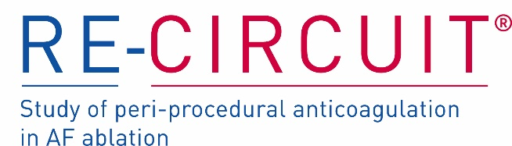
Periprocedural anticoagulation for catheter ablation of AF
ESC
Hindricks et al. Eur Heart J 2020, p. 52; see Figure 17 (p. 46) for full details
New
recommendations
Pre-procedural management of stroke risk includes initiation of anticoagulation (Class I, Level C)
  Preferably for at least 3 weeks before ablation (Class IIa, Level C)
Performance of the ablation without OAC interruption is recommended (Class I, Level A)
Updated
recommendations
After the procedure it is recommended that: (Class I, Level C)
Systemic anticoagulation with warfarin or a NOAC is continued for at least 2 months
Long-term continuation of systemic anticoagulation beyond 2 months post-ablation is based on the patient’s stroke risk profile
RCT
Calkins et al. NEJM 2017
Showed a lower risk of major bleeding during and up to
8 weeks post-ablation with uninterrupted dabigatran vs uninterrupted warfarin
i
Click to see data
Hindricks et al. Eur Heart J 2020; doi:10.1093/eurheartj/ehaa612; Calkins et al. NEJM 2017;376:1627
Notes:
Although there is some variability in the peri-procedural OAC management in patients undergoing AF ablation, more recently operators have moved towards a strategy of performing the ablation under uninterrupted VKA or NOAC treatment, provided the INR is within therapeutic range. In non-anticoagulated patients, initiating therapeutic anticoagulation 3–4 weeks before ablation may be considered.
Reference
Hindricks et al. Eur Heart J 2020; doi:10.1093/eurheartj/ehaa612

Slide 13
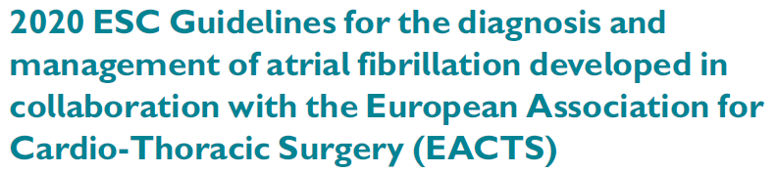
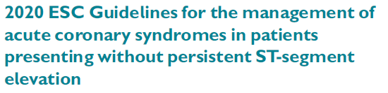
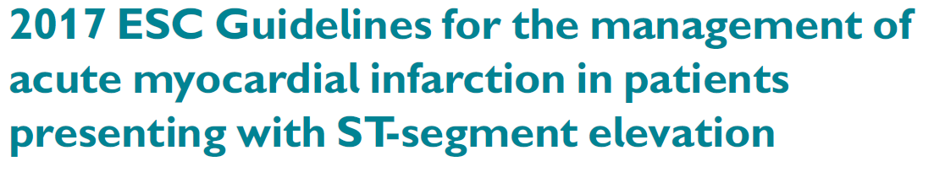

What ESC guidelines are available for management of CAD and/or PCI in patients with AF?
Hindricks et al. Eur Heart J 2020¹
Contains recommendations on:
Further information:
Post-procedure management of patients with AF and ACS or CCS undergoing PCI
Go to slides 14–15 for overview of relevant recommendations for patients with AF
i
Collet et al. Eur Heart J 2020²
Management of ACS in patients presenting without persistent ST-segment elevation myocardial infarction (NSTEMI)
Go to slide 16 for overview of relevant recommendations for patients with AF
i
Ibanez et al. Eur Heart J 2018³
Management of ACS in patients presenting with persistent ST-segment elevation myocardial infarction (STEMI)
Note: these guidelines were published before the results from RE-DUAL PCI, AUGUSTUS, and ENTRUST AF-PCI were available
Knuuti et al. Eur Heart J 2020⁴
Management of CCS
See slide notes for summary of recommendations in patients with AF
ACS, acute coronary syndrome; CAD, coronary artery disease; CCS, chronic coronary syndrome; PCI, percutaneous coronary intervention
1. Hindricks et al. Eur Heart J 2020; doi:10.1093/eurheartj/ehaa612; 2. Collet et al. Eur Heart J 2020; doi:10.1093/eurheartj/ehaa575; 3. Ibanez et al. Eur Heart J 2018;39:119; 4. Knuuti et al. Eur Heart J 2020;41:407
Notes:
2019 ESC Guidelines for the diagnosis and management of chronic coronary syndromes
Antithrombotic therapy in patients with CCS and AF:
When oral anticoagulation is initiated in a patient with AF who is eligible for a NOAC, a NOAC is recommended in preference to a VKA (Class I, Level A)
Long-term OAC therapy (a NOAC or VKA with time in therapeutic range >70%) is recommended in patients with AF and a CHA₂DS₂-VASc score ≥2 in males and ≥3 in females (Class I, Level A)
Long-term OAC therapy (a NOAC or VKA with time in therapeutic range >70%) should be considered in patients with AF and a CHA₂DS₂-VASc score of 1 in males and 2 in females (Class IIa, Level B)
Reference
Knuuti et al. Eur Heart J 2020;41:407

Slide 14

Antithrombotic therapy in patients with AF post-PCI (1/2)
ESC
Hindricks et al. Eur Heart J 2020, p. 62
New
recommendations
AF patients with ACS
In AF patients with ACS undergoing an uncomplicated PCI, early cessation (≤1 week) of ASA and continuation of dual therapy with an OAC and a P2Y12 inhibitor (preferably clopidogrel) for up to 12 months is recommended if the risk of stent thrombosis* is low or if concerns about bleeding risk† prevail over concerns about risk of stent thrombosis,* irrespective of the type of stent used (Class I, Level A)
AF patients with a CCS undergoing PCI
After uncomplicated PCI, early cessation (≤1 week) of ASA and continuation of dual therapy with OAC for up to 6 months and clopidogrel is recommended if the risk of stent thrombosis* is low or if concerns about bleeding risk† prevail over concerns about risk of stent thrombosis,* irrespective of the type of stent used
(Class I, Level A)
RCT
Cannon et al. NEJM 2017
Dual antithrombotic therapy using SPAF-approved dabigatran doses provided a major net clinical benefit: significantly reduced MBE vs triple therapy with VKA, without compromising ischaemic events
i
Click to see data
ACS, acute coronary syndrome; ASA, acetylsalicylic acid; CCS, chronic coronary syndrome; MBE, major bleeding event; PCI, percutaneous coronary
intervention. Hindricks et al. Eur Heart J 2020; doi:10.1093/eurheartj/ehaa612; Cannon et al. NEJM 2017;377:1513. Footnotes are provided in slide notes
Notes:
*Risk of stent thrombosis encompasses: (i) risk of thrombosis occurring, and (ii) risk of death should stent thrombosis occur, both of which relate to anatomical, procedural, and clinical characteristics. Risk factors for CCS patients include: stenting of left main stem or last remaining patent artery; suboptimal stent deployment; stent length >60 mm; diabetes mellitus; chronic kidney disease; bifurcation with two stents implanted; treatment of chronic total occlusion; and previous stent thrombosis on adequate antithrombotic therapy.
†Bleeding risk in AF patients may be assessed using the HAS-BLED score, which draws attention to modifiable bleeding risk factors; those at high risk (score ≥3) can have more frequent or early review and follow-up. Bleeding risk is highly dynamic and does not remain static, and relying on modifiable bleeding risk factors alone is an inferior strategy to evaluate bleeding risk.
Reference
Hindricks et al. Eur Heart J 2020; doi:10.1093/eurheartj/ehaa612

Slide 15
Antithrombotic therapy in patients with AF post-PCI (2/2)
ESC
Hindricks et al. Eur Heart J 2020: Figure 20, p. 61
Intraprocedural parenteral anticoagulation
if on NOAC or INR ≤2.5 on VKA
≤1 week
1 month 3 months 6 months
12 months
OAC (NOAC or VKA)
ACS
PCI
(N)OAC
Long term
P2Y12 inhibitor
ASA
Fibrinolysis only if OAC is below therapeutic reference range
Medically treated ACS
(N)OAC
Long term
Single antiplatelet drug (preferably P2Y12 inhibitor)
Intraprocedural parenteral anticoagulation
VKA/NOAC
CCS
INR 2.0–2.5
PCI
(N)OAC
Long term
P2Y12 inhibitor
ASA
i
Click to see data
‘Overall, dual antithrombotic therapy including OAC (preferably NOAC) and a P2Y12 inhibitor (preferably clopidogrel) is associated with significantly less major bleeding (and ICH) than triple therapy.
However, available evidence suggests that at least a short course of triple therapy (e.g. ≤1 week) would be desirable in some AF patients after a recent ACS or undergoing PCI, especially in those at increased risk of ischaemic events’
ACS, acute coronary syndrome; ASA, acetylsalicylic acid; CCS, chronic coronary syndrome; ICH, intracranial haemorrhage; PCI, percutaneous coronary intervention
Hindricks et al. Eur Heart J 2020; doi:10.1093/eurheartj/ehaa612
Notes:
Thrombotic risk factors
Diabetes mellitus requiring therapy
Prior ACS/recurrent myocardial infarction
Multivessel CAD
Concomitant PAD
Premature CAD (occurring at age of <45 years) or accelerated CAD (new lesion within 2 years)
CKD (eGFR <60 mL/min)
Clinical presentation (ACS)
Multivessel stenting
Complex revascularization (left main stenting, bifurcation lesion stenting, chronic total occlusion intervention, last patent vessel stenting)
Prior stent thrombosis on antiplatelet treatment
Procedural factors (stent expansion, residual dissection, stent length etc)
Bleeding risk factors
Hypertension
Abnormal renal or liver function
Stroke or ICH history
Bleeding history or bleeding diathesis (e.g. anaemia with haemoglobin <110 g/L)
Labile INR (if on VKA)
Elderly (>65 years)
Drugs (concomitant OAC and antiplatelet therapy, NSAIDs), excessive alcohol consumption
Strategies to reduce bleeding associated with PCI
Radial artery access
PPIs in patients taking DAPT who are at increased risk of bleeding (e.g. the elderly, or those with dyspepsia, gastro-oesophageal reflux disease, Helicobacter pylori infection, chronic alcohol use)
Non-administration of unfractionated heparin in patients on VKA with INR >2.5
Pre-treatment with ASA only; add a P2Y12 inhibitor when coronary anatomy is known or if STEMI
Glycoprotein IIb/IIIa inhibitors only for bailout or periprocedural complications
Shorter duration of combined antithrombotic therapy
CAD, coronary artery disease; CKD, chronic kidney disease; DAPT, dual antiplatelet therapy; eGFR, estimated glomerular filtration rate; ICH, intracranial haemorrhage; PAD, peripheral artery disease; PPI, proton pump inhibitor; STEMI, ST-segment elevation myocardial infarction
Reference
Hindricks et al. Eur Heart J 2020; doi:10.1093/eurheartj/ehaa612

Slide 16
Antithrombotic therapy in patients with AF post-PCI (NSTE-ACS)
ESC
Collet et al. Eur Heart J 2020: Figure 8, p. 32
Default Strategy
Time from treatment initiation
AF patients undergoing PCI for NSTE-ACS
Dual antithrombotic therapy with a NOAC at the recommended dose for stroke prevention and single antiplatelet therapy (preferably clopidogrel) is recommended as the default strategy up to 12 months after a short period (up to 1 week) of triple antithrombotic therapy
Default Strategy
High Bleeding Risk
High Ischaemic Risk
up to 1 week (in hospital)
Triple therapy: (N)OAC + DAPT (ASA + P2Y12 receptor inhibitor)
Double Therapy
(N)OAC + SAPT
Double Therapy
(N)OAC + SAPT
Triple Therapy
High Bleeding Risk
1 month
In patients with high bleeding risk, dual antithrombotic therapy should be shortened to 6 months by withdrawing the ongoing antiplatelet therapy
Double Therapy
(N)OAC + SAPT
3 months
6 months
High Ischaemic Risk
(N)OAC alone
In patients with high coronary ischaemic risk, triple antithrombotic therapy should be prolonged up to 1 month, followed by dual antithrombotic therapy for up to 12 months
12 months
(N)OAC alone
i
Click to see data
Green (Class I) and yellow (Class IIa) colours denote the classes of recommendation. ASA, acetylsalicylic acid; DAPT, dual antiplatelet therapy; NSTE-ACS, non-ST-segment elevation acute coronary syndrome; PCI, percutaneous coronary intervention; SAPT, single antiplatelet therapy
Collet et al. Eur Heart J 2020; doi:10.1093/eurheartj/ehaa575

Slide 17
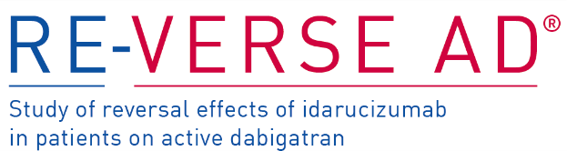
NOAC reversal: a rapidly acting, specific reversal agent for anticoagulation can help the clinical management of major life-threatening events
ESC
Hindricks et al. Eur Heart J 2020, p. 66
Recommendation
Severe or life-threatening bleeding in patients on NOACs
Consider specific antidote, or PCC if no antidote available
The ESC guideline states:
‘Specific reversal drugs are available for NOACs: idarucizumab (for dabigatran) and andexanet alfa (for FXa inhibitors) effectively reverse the anticoagulation action of NOACs and restore physiological haemostasis’
The guideline does not highlight that idarucizumab is the only specific reversal agent indicated for the rapid reversal of dabigatran anticoagulation in patients requiring emergency surgery or urgent intervention
However…
RCT
Pollack et al. NEJM 2017
Showed immediate, complete, and sustained reversal of dabigatran anticoagulation in patients with life-threatening bleeding or requiring urgent surgery/procedures
i
Click to see data
PCC, prothrombin complex concentrate
Hindricks et al. Eur Heart J 2020; doi:10.1093/eurheartj/ehaa612; Pollack et al. NEJM 2017;377:431; Praxbind SPC, 2020; Praxbind US PI, 2018

Slide 18
Optimized stroke prevention is a key component of AF management; ESC guidelines recommend integrated AF management and patient-individualized care
Integrated AF management
Patient-centred
Optimized stroke prevention
Symptom control with rate or rhythm control
Management of cardiovascular risk factors/comorbidities
Patient education/self-management (including personal goals and/or action plan, exacerbation management)
Healthcare professional education
Lifestyle modification
(i.e. smoking cessation, dietary intervention to lose weight, exercise)
Psychosocial management
(cognitive behavioural therapy, stress management, other psychological assessment and/or treatment)
“
Integrated management of AF patients requires a coordinated and agreed patient-individualized care pathway to deliver optimized treatment by an interdisciplinary team
Strategies to promote medication adherence
Multidisciplinary team approach
Active participation and formation of teams of HCPs from different disciplines; integration of services, MDT meeting (as needed)
Structured follow-up and clear communication between primary and secondary care
”
HCP, healthcare professional; MDT, multidisciplinary team. Hindricks et al. Eur Heart J 2020; doi:10.1093/eurheartj/ehaa612

Slide 19
Appraisal of some
important information with respect to dabigatran data as represented in the ESC guidelines on diagnosis and management of AF

Slide 20
ESC 2020 guidelines: key statements and clarifications
?
What do the ESC guidelines say?¹
◆
!
What extra information is important to remember?
p. 51: ‘NOACs have at least comparable efficacy and safety to warfarin in AF patients undergoing cardioversion’
This statement does not differentiate between the NOACs in cardioversion, and therefore supports dabigatran and the FXa inhibitors
Data on dabigatran in patients requiring cardioversion are based on a subgroup of RE-LY;² in contrast, FXa inhibitors were investigated in non-powered RCTs^{3–5}
p. 52: ‘For patients undergoing AF catheter ablation who have been therapeutically anticoagulated with warfarin, dabigatran, rivaroxaban, apixaban, or edoxaban, performance of the ablation procedure without OAC interruption is recommended (Class I, Level A)’
The recommendations are classed equally for all OACs
However, it’s important to recognize that RE-CIRCUIT was the only RCT that showed a significantly reduced risk of ISTH major bleeding for an uninterrupted OAC vs warfarin⁶
The 2017 HRS/EHRA/ECAS/APHRS/SOLAECE consensus statement* states that for patients undergoing AF catheter ablation who have been therapeutically anticoagulated:⁷
  with warfarin or dabigatran, performance of the ablation procedure without interruption of warfarin or dabigatran is recommended (Class I, Level A)
  with rivaroxaban, performance of the ablation procedure without interruption of rivaroxaban is recommended (Class I, Level B-R)
  with a NOAC other than dabigatran or rivaroxaban, performance of the ablation procedure without withholding a NOAC dose is reasonable (Class IIA, Level B-NR)
*Results from AXAFA-AFNET 5 and ELIMINATE-AF were not available at the time of publication. APHRS, Asia Pacific Heart Rhythm Society; B-NR, level B non-randomized; B-R, level B randomized; ECAS, European Cardiac Arrhythmia Society; EHRA, European Heart Rhythm Association; HRS, Heart Rhythm Society; ISTH, International Society on Thrombosis and Haemostasis; RCT, randomized controlled trial; SOLAECE, Sociedad Latinoamericana de Estimulación Cardiaca y Electrofisiologia. 1. Hindricks et al. Eur Heart J 2020; doi:10.1093/eurheartj/ehaa612; 2. Nagarakanti et al. Circulation 2011;123:131; 3. Cappato et al. Eur Heart J 2014;35:3346; 4. Ezekowitz et al. Eur Heart J 2018;39:2959; 5. Goette et al. Lancet 2016;388:1995; 6. Calkins et al. NEJM 2017;376:1627; 7. Calkins et al. Europace 2018;20:e1

Slide 21
ESC 2020 guidelines: key statements and clarifications
?
What do the ESC guidelines say?¹
◆
!
What extra information is important to remember?
p. 35: ‘In patients with a recent bleeding event, attention should be
directed towards addressing the predisposing pathology (e.g. bleeding ulcer or polyp in a patient with gastrointestinal bleeding), and the reintroduction of OAC as soon as feasible, as part of a multidisciplinary team decision. Consideration should be made for drugs such as apixaban or dabigatran 110 mg BID, which are not associated with an excess of gastrointestinal bleeding compared with warfarin’
This statement supports both dabigatran and apixaban, because the guidelines highlight that apixaban and dabigatran 110 mg BID are suitable drugs to consider based on their GI bleeding safety profile
  In RE-LY, GI bleeding with dabigatran 110 mg BID was similar vs warfarin (relative risk: 1.08; 95% CI: 0.85–1.38)²
  In RE-LY, two dabigatran doses (150 mg and 110 mg BID) were independently randomized vs warfarin and hence provide physicians with options to tailor the dose to the individual needs of patients^{2–4}
p. 66: ‘Idarucizumab (for dabigatran) and andexanet alfa (for FXa inhibitors) effectively reverse the anticoagulation action of NOACs and restore physiological haemostasis. However, their use is often associated with subsequent non-reinitiation of OAC and increased rates of thrombotic events’
The statement does not differentiate between the data for andexanet alfa and idarucizumab
The andexanet alfa prescribing information has a black box warning from the US FDA:
  Treatment with andexanet alfa has been associated with serious and life-threatening adverse events including arterial and venous thromboembolic events; ischemic events, including myocardial infarction and ischemic stroke; cardiac arrest; and sudden deaths⁵
There is no equivalent boxed warning in the idarucizumab prescribing information⁶
1. Hindricks et al. Eur Heart J 2020; doi:10.1093/eurheartj/ehaa612; 2. Connolly et al. NEJM 2010;363:1875; 3. Connolly et al. NEJM 2009;361:1139; 4. Connolly et al. NEJM 2014;371:1464; 5. Andexxa US PI, 2020; 6. Praxbind US PI, 2020

Slide 22
ESC 2020 guidelines: key statements and clarifications (post-PCI)
?
What do the ESC guidelines say?¹
◆
!
What extra information is important to remember?
p. 60: ‘All four trials had a primary safety endpoint (i.e. bleeding) and were underpowered to assess ischaemic outcomes’
The guideline does not indicate that RE-DUAL PCI was sufficiently powered to assess the composite efficacy endpoint of death, thromboembolic event, and revascularization for both dabigatran doses combined²
p. 60: ‘The risk of myocardial infarction or stent thrombosis was slightly higher with dabigatran 110 mg but not dabigatran 150 mg’
Additional information from RE-DUAL PCI can help to put this statement into context:
The increases for D110-DT were numerically, not statistically, significant²
Similar numbers of events were observed with D150-DT as for warfarin-TT²
p. 60: Content in Box 1 notes that while there was some heterogeneity in the RCTs investigating NOACs in dual vs triple therapy post-PCI, they were consistent in many aspects
The guideline does not elaborate on key factors that vary between the four trials e.g.:
The number of patients with ACS who underwent PCI varies from 37.3% in AUGUSTUS to 50.5% in RE-DUAL PCI^{2–5}
The actual mean time from PCI to randomization varies from 1.7 days in RE-DUAL PCI to 6.6 days in AUGUSTUS^{3–6}
These are important in terms of the severity of illness that patients had and the duration of time that ASA was on board; differences such as these make cross-trial comparisons difficult
p. 62: In patients at high bleeding risk (HAS-BLED ≥3), rivaroxaban 15 mg OD and dabigatran 110 mg BID are recommended in preference to rivaroxaban 20 mg OD and dabigatran 150 mg BID, respectively, for the duration of concomitant single or DAPT, to mitigate bleeding risk
(Class IIa, Level B)
The recommendations are classed equally, despite significant differences in how these drugs were tested in the pivotal Phase III trials for stroke prevention in AF:
RE-LY: dabigatran 110 mg BID was fully tested in 6015 patients in an independent treatment arm vs warfarin⁷
ROCKET AF: only 1474 patients received a reduced dose of rivaroxaban
15 mg OD⁸
ACS, acute coronary syndrome; ASA, acetylsalicylic acid; D150, dabigatran 150 mg BID; D110, dabigatran 110 mg BID; DAPT, dual antiplatelet therapy; DT, dual therapy; PCI, percutaneous coronary intervention; RCT, randomized controlled trial; TT, triple therapy. 1. Hindricks et al. Eur Heart J 2020; doi:10.1093/eurheartj/ehaa612; 2. Cannon et al. NEJM 2017;377:1513; 3. Gibson et al. NEJM 2016;375:2423; 4. Lopes et al. NEJM 2019;80:1509; 5. Vranckx et al. Lancet 2019;394:1335; 6. Boehringer Ingelheim. Data on file; 7. Connolly et al. NEJM 2009;361:1139; 8. Fox et al. Eur Heart J 2011;32:2387

Slide 23
Summary
The ESC 2020 AF management guidelines recommend the AF Better Care (ABC) approach, which aims to further improve the structured management of AF patients, promote patient values, and improve patient outcomes
1
NOACs are recommended over VKAs for stroke prevention in AF (Class 1, Level A); however, the guidelines usually provide the same class of recommendation for all NOACs independent of important differences seen in respective RCTs
2
The safety and efficacy of dabigatran has been confirmed in a broad spectrum of patients with AF. Both approved doses of dabigatran are fully tested for stroke prevention in independent treatment arms in RE-LY, allowing flexibility when treating patients throughout their lives
3
RCT, randomized controlled trial

Slide 24
Appendix

Slide 25
Stroke prevention in AF: comparison of recent international guidelines
Recommendations of oral anticoagulants for stroke prevention based on stroke risk and the risk reassessment
Guidelines | Tipping points and the recommendations for stroke prevention | Statements or recommendations about the risk reassessment
2017 APHRS | OACs for patients with a score ≥1 (males) or ≥2 (females) | None
2018 ACCP | OACs should be offered for patients with a score ≥1 (males) or ≥2 (females) | Stroke risk is dynamic, and risk should be reassessed at every patient visit
2019 ACC/AHA/HRS | Class IIb recommendation – OACs for score 1 (males) or 2 (females) Class I recommendation – OACs for score ≥2 (males) or ≥3 (females) | Re-evaluation of the need for and choice of anticoagulant therapy at periodic intervals is recommended to reassess stroke and bleeding risks
2020 ESC | Class IIa recommendation – OACs for score 1 (males) or 2 (females) Class I recommendation – OACs for score ≥2 (males) or ≥3 (females) | Class I recommendation – stroke and bleeding risk reassessment at periodic intervals is recommended to inform treatment decisions (e.g. initiation of OAC in patients no longer at low risk of stroke) and address potentially modifiable bleeding risk factors Class IIa recommendation – in patients with AF initially at low risk of stroke, first reassessment of stroke risk should be made 4–6 months after the index evaluation
Key points in all four guidelines:
The CHA₂DS₂-VASc score is recommended for stroke risk assessment
OAC (preferably NOACs in all NOAC-eligible patients) is recommended for AF patients with a CHA₂DS₂-VASc score ≥2 (males) or ≥3 (females)
⧫
ACC, American College of Cardiology; ACCP, American College of Chest Physicians; AHA, American Heart Association; APHRS, Asia Pacific Heart Rhythm Society; HRS, Heart Rhythm Society. Chao et al. Eur Heart J Suppl 2020;22(Suppl O):O53

Slide 26
Both doses of dabigatran showed a favourable safety and efficacy profile vs warfarin in the overall RE-­LY population
D150
vs warfarin
D110
vs warfarin
HR
P value
HR
P value
Stroke/SE
0.65
<0.001
0.89
0.27
Ischaemic
stroke
0.76
0.0351
1.13
0.3138
Major
bleeding
0.94
0.41
0.80
0.003
GI bleeding
1.48
0.001
1.08
0.52
ICH
0.41
<0.001
0.30
<0.001
All-cause mortality
0.88
0.051
0.91
0.13
Favours dabigatran
Favours warfarin
Favours dabigatran
Favours dabigatran
Favours warfarin
Favours dabigatran
Favours dabigatran
Favours warfarin
HR (95% CI)
HR (95% CI)
⧫
Favourable safety for dabigatran 150 mg BID vs warfarin refers to major bleeding events including ICH
Bold values indicate statistical significance. D150, dabigatran 150 mg BID; D110, dabigatran 110 mg BID; ICH, intracranial haemorrhage;
SE, systemic embolism. Connolly et al. NEJM 2010;363:1875; Connolly et al. NEJM 2014;371:1464; Pradaxa SPC, 2021
Notes:
ICH is a subset of major bleeding.
HR (95% CI) for dabigatran 150 mg BID
Stroke/SE 0.65 (0.52–0.81); P<0.001
Ischaemic stroke 0.76 (0.59–0.98); P=0.0351
Major bleeding 0.94 (0.82–1.08); P=0.41
GI bleeding 1.48 (1.18–1.85); P=0.001
ICH 0.41 (0.28–0.60); P<0.001
All-cause mortality 0.88 (0.77–1.00); P=0.051
Haemorrhagic stroke 0.26 (0.14–0.49); P<0.001
CV mortality 0.85 (0.72–0.99); P=0.04
Hospitalization 0.97 (0.92–1.03); P=0.34
HR (95% CI) for dabigatran 110 mg BID
Stroke/SE 0.89 (0.73–1.09); P=0.27
Ischaemic stroke 1.13 (0.89–1.42); P=0.3138
Major bleeding 0.80 (0.70–0.93); P=0.003
GI bleeding 1.08 (0.85–1.38); P=0.52
ICH 0.30 (0.19–0.45); P<0.001
All-cause mortality 0.91 (0.80–1.03); P=0.13
Haemorrhagic stroke 0.31 (0.17–0.56); P<0.001
CV mortality 0.90 (0.77–1.06); P=0.21
Hospitalization 0.92 (0.87–0.97); P=0.003
References
Connolly et al. NEJM 2010;363:1875
Connolly et al. NEJM 2014;371:1464
Pradaxa SPC, 2021

Slide 27
Low rates of major bleeding and stroke/SE among patients undergoing
AF cardioversion in RE-LY
Major bleeding
Stroke/SE
RR: 0.99
(95% CI: 0.25–3.93)
P=0.99
RR: 0.49
(95% CI: 0.09–2.69)
P=0.40
RR: 2.82
(95% CI: 0.90–8.82)
P=0.06
RR: 1.28
(95% CI: 0.35–4.76)
P=0.71
Major bleeding (%)
Stroke/SE (%)
1.70
0.60
0.60
0.77
0.60
0.30
D150 (n=672)
D110
(n=647)
Warfarin (n=664)
D150 (n=672)
D110
(n=647)
Warfarin (n=664)
Event rates were low in all treatment arms; no significant differences for dabigatran vs warfarin were seen
Dabigatran is a reasonable alternative to warfarin in patients with AF requiring cardioversion
⧫
D150, dabigatran 150 mg BID; D110, dabigatran 110 mg BID; RR, relative risk; SE, systemic embolism
Nagarakanti et al. Circulation 2011;123:131

Slide 28
RE-CIRCUIT: lower risk of major bleeding during and after ablation with dabigatran vs warfarin
Absolute risk difference:
–5.3% (P<0.001)
Relative risk reduction: 77.2%
 | Dabigatran 150 mg BID | Warfarin
Patients with ISTH MBEs, n | 5 | 22
ISTH MBEs, n* | 5 | 23†
Pericardial tamponade | 1 | 6
Pericardial effusion | 1 | 0
Groin bleed | 2 | 2
Groin haematoma | 0 | 8
GI bleed | 1 | 2
Intracranial bleed | 0 | 2
Pseudoaneurysm | 0 | 1
Haematoma | 0 | 2
Required medical action, n | 4 | 21
Intervention/procedure | 1 | 11
*Based on number of events rather than number of patients; †One patient had two adjudicated ISTH MBEs; MBEs during ablation and up to 8 weeks post-ablation
ISTH, International Society on Thrombosis and Haemostasis; MBE, major bleeding event
Calkins et al. NEJM 2017;376:1627

Slide 29
RE-CIRCUIT: comparable rates of minor bleeding, thromboembolic events, and a composite of MBE and thromboembolic events
Dabigatran 150 mg BID, n=317
Warfarin, n=318
59
(18.6%)
54
(17.0%)
Events (%)
23
(7.2%)
0
(0%)
1
(0.3%)*
5
(1.6%)
⧫
*One patient had a transient ischaemic attack
MBE, major bleeding event
Calkins et al. NEJM 2017;376:1627

Slide 30
Key characteristics of patients enrolled in trials investigating antithrombotic regimens in patients with AF and CAD in the post-PCI setting
PIONEER AF-PCI¹
Rivaroxaban
RE-DUAL PCI²
Dabigatran
AUGUSTUS³
Apixaban
ENTRUST-AF PCI⁴
Edoxaban
2.5 mg BID
150 mg BID
NOAC doses tested
5 mg BID*
60 mg OD†
15 mg OD
110 mg BID
Patients undergoing PCI (%)
100
100
76.1
100
Patients with ACS (%)
52.3
50.5
37.3
51.6
Time from PCI to randomization (days)‡
Per protocol
≤3
Actual (mean)
1.7⁵
Actual (mean)
6.6
Actual (median)
1.9
In RE-DUAL PCI, SPAF-approved NOAC doses were used and all enrolled patients underwent PCI, half of whom required PCI for acute coronary events
Not for direct comparison because of differences in study design and populations
*Apixaban 2.5 mg BID if ≥2 of the following criteria were met: age ≥80 years, weight ≤60 kg, or serum creatinine ≥1.5 mg/dL (133 μmol/L); †Edoxaban 30 mg OD if ≥1 of the following criteria were met: CrCl 15–50 mL/min, bodyweight ≤60 kg, or concomitant use of specified potent P-glycoprotein inhibitors; ‡In AUGUSTUS, data are time from PCI and/or ACS to randomization. ACS, acute coronary syndrome; CAD, coronary artery disease; CrCl, creatinine clearance; PCI, percutaneous coronary intervention. 1. Gibson et al. NEJM 2016;375:2423; 2. Cannon et al. NEJM 2017;377:1513; 3. Lopes et al. NEJM 2019;80:1509; 4. Vranckx et al. Lancet 2019;394:1335; 5. Boehringer Ingelheim. Data on file

Slide 31
RE-DUAL PCI: significantly lower rates of ISTH major bleeding or
CRNMBE with dabigatran dual therapy vs warfarin triple therapy
HR: 0.72 (95% CI: 0.58–0.88)
P=0.002
HR: 0.52 (95% CI: 0.42–0.63)
P<0.001
ARR: 5.5%
264
(26.9%)
196
(25.7%)
ARR: 11.5%
154
(20.2%)
Patients with outcome event (%)
151
(15.4%)
ARR, absolute risk reduction; CRNMBE, clinically relevant non-major bleeding event; ISTH, International Society on Thrombosis and Haemostasis
Cannon et al. NEJM 2017;377:1513

Slide 32
RE-DUAL PCI: dabigatran dual therapy was non-inferior to warfarin triple therapy in the composite efficacy endpoint
Composite endpoint of death or thromboembolic event (MI, stroke, or systemic embolism) or unplanned revascularization (PCI/CABG)
35
HR: 1.04 (95% CI: 0.84–1.29)
Non-inferiority P=0.005
30
25
13.7%
13.4%
Dabigatran (combined doses)
dual therapy
20
Cumulative incidence of event (%)
Patients with outcome event (%)
15
Warfarin
triple therapy
10
5
0
0
90
180
270
360
450
540
630
720
Time to first event (days)
⧫
CABG, coronary artery bypass grafting; MI, myocardial infarction; PCI, percutaneous coronary intervention
Cannon et al. NEJM 2017;377:1513

Slide 33
ACS in RE-DUAL PCI (50.5% of patients): lower bleeding and similar efficacy with dabigatran-DT vs warfarin-TT, regardless of ACS status
ISTH major/CRNM bleeding
D150, n | W, n | D150, % | W, % | P inter-action
391 | 369 | 20.5 | 27.1 | 0.57
372 | 394 | 19.9 | 24.4
D110, n | W, n | D110, % | W, % | P inter-action
509 | 475 | 14.7 | 27.8 | 0.34
472 | 505 | 16.1 | 26.1
ACS
Non-ACS
DTE or unplanned revascularization
ACS
391 | 369 | 10.5 | 14.1 | 0.11
372 | 394 | 13.2 | 11.7
509 | 475 | 18.1 | 14.7 | 0.38
472 | 505 | 12.1 | 12.1
Non-ACS
Favours D150-DT
Favours warfarin-TT
Favours D110-DT
Favours warfarin-TT
HR (95% CI)
HR (95% CI)
⧫
ACS, acute coronary syndrome; CRNM, clinically relevant non-major; D150, dabigatran 150 mg BID; D110, dabigatran 110 mg BID; DT, dual therapy; DTE, death or thromboembolic event; ISTH, International Society on Thrombosis and Haemostasis; TT, triple therapy; W, warfarin
Oldgren et al. Eur Heart J 2019;40:1553

Slide 34
RE-DUAL PCI: similar or better ISTH major/CRNM bleeding with dabigatran-DT vs warfarin-TT, regardless of HAS-BLED score
ISTH major/CRNM bleeding
D150, n | W, n | D150, % | W, % | P inter-action
316 | 260 | 14.6 | 21.9 | 0.27
447 | 504 | 24.2 | 27.6
D110, n | W, n | D110, % | W, % | P inter-action
336 | 291 | 12.2 | 23.0 | 0.58
645 | 690 | 17.1 | 28.6
HAS-BLED score
0–2
≥3
Favours D150-DT
Favours warfarin-TT
Favours D110-DT
Favours warfarin-TT
HR (95% CI)
HR (95% CI)
CRNM, clinically relevant non-major; D150, dabigatran 150 mg BID; D110, dabigatran 110 mg BID; DT, dual therapy; ISTH, International Society on Thrombosis and Haemostasis; TT, triple therapy; W, warfarin
Lip et al. Am Heart J 2019;212:13

Slide 35
RE-DUAL PCI: similar or better efficacy with dabigatran-DT vs warfarin-TT, regardless of CHA₂DS₂-VASc score
Death, thromboembolic event, or unplanned revascularization
D150, n | W, n | D150, % | W, % | P inter-action
79 | 55 | 5.1 | 18.2 | 0.08
168 | 129 | 8.9 | 8.5
516 | 580 | 13.8 | 13.3
D110, n | W, n | D110, % | W, % | P inter-action
69 | 55 | 15.9 | 18.2 | 0.74
161 | 138 | 13.0 | 8.7
751 | 788 | 15.6 | 13.8
CHA₂DS₂-VASc score
0–1
2
≥3
Favours D150-DT
Favours warfarin-TT
Favours D110-DT
Favours warfarin-TT
HR (95% CI)
HR (95% CI)
⧫
D150, dabigatran 150 mg BID; D110, dabigatran 110 mg BID; DT, dual therapy; TT, triple therapy; W, warfarin
Lip et al. Am Heart J 2019;212:13

Slide 36

A rapidly acting, specific reversal agent for anticoagulation can help the clinical management of major life-threatening events
Emergency interventions
(e.g. emergency lumbar puncture, thrombolysis for acute ischaemic stroke)
Urgent surgery
(e.g. due to an aneurysm)
Life-threatening bleeding
(e.g. subdural haematoma after a fall)
Patients with AF are often elderly, with multiple comorbidities, and at higher risk of these events
Pollack et al. NEJM 2017;377:431; Freeman et al. Circulation 2017;135:1227
Notes:
Anticoagulation in patients with AF is usually lifelong and individuals may require multiple procedures.
A specific reversal agent can remove the anticoagulant effect, but other measures (e.g. surgery, fluid replacement) would still be required to correct the underlying cause of the bleed (e.g. vessel rupture) and its consequences (e.g. shock).
Reference
Levy et al. J Thromb Haemost 2016;14:623

Slide 37
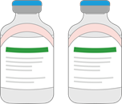

Idarucizumab was designed as a specific reversal agent for the anticoagulant activity of dabigatran
Type of agent
Humanized antibody (Fab) fragment
Specificity
Specific to dabigatran
Binding affinity for dabigatran
~350× higher than that of dabigatran for thrombin;
binds dabigatran irreversibly
Intrinsic activity
No intrinsic procoagulant or
anticoagulant activity
Endogenous targets
No endogenous targets; does not reverse heparins
or any other anticoagulants
Administration
Ready-to-use solution for IV administration;
immediate onset of action
Fab, antigen-binding fragment. Schiele et al. Blood 2013;121:3554; Schmohl et al. Thromb Haemost 2017;117:269; Praxbind SPC, 2020
Notes:
Idarucizumab is a humanized antibody fragment that binds to dabigatran with a more than 350-fold higher affinity than dabigatran does to thrombin, thus preventing dabigatran from binding to thrombin and so reversing its anticoagulant effects. Humanization of the antibody fragment and the removal of the Fc region reduce the immunogenic potential of the molecule.
The antibody fragment does not bind to known thrombin substrates and has no activity in coagulation tests or platelet aggregation, and thus has no procoagulant or anticoagulant effects on its own.
Idarucizumab binds rapidly to dabigatran and the idarucizumab–dabigatran complex is eliminated quickly. This potentially allows a patient to resume dabigatran treatment soon after the bleeding event has been resolved.
Idarucizumab has no known endogenous targets. It is highly specific to dabigatran, which has no naturally occurring homologues in the human body.
Due to its intravenous application route, idarucizumab has a fast onset of action.
References
Schiele et al. Blood 2013;121:3554
Schmohl et al. Thromb Haemost 2017;117:269
Praxbind SPC, 2020

Slide 38
RE-VERSE AD: immediate, complete, and sustained reversal of dabigatran anticoagulation in patients with bleeding or requiring surgery
Based on diluted thrombin time (dTT)
Group A: uncontrolled bleeding (n=293)
Group B: emergency surgery or procedure (n=195)
120
120
110
110
Similar results obtained when dabigatran reversal was measured as ECT, TT, aPTT, and unbound dabigatran
100
100
90
90
80
80
dTT (s)
dTT (s)
70
Idarucizumab
2×2.5 g
70
Idarucizumab
2×2.5 g
60
60
50
50
40
40
30
30
0
0
Baseline
Between
vials
10–30
min
1 h
2 h
4 h
12 h
24 h
Baseline
Between
vials
10–30
min
1 h
2 h
4 h
12 h
24 h
Time post-idarucizumab
Time post-idarucizumab
Median and 25th/75th percentiles
10th/90th percentiles
5th/95th percentiles
Assay upper limit of normal
aPTT, activated partial thromboplastin time; ECT, ecarin clotting time; TT, thrombin time. Pollack et al. NEJM 2017;377:431

Slide 39
RE-VERSE AD Group A: efficacy of idarucizumab demonstrated in patients with life-threatening bleeding
301 patients with
bleeding type classed as:
Assessable
non-ICH
(n=198)
Median time to
bleeding cessation†‡
ICH (non-
assessable)*
(n=98)
2.5 hours
Non-assessable
non-ICH (n=5)
*Serial computed tomography (CT) scans were not mandated by the protocol; †Cessation confirmed within 24 hours in 134/198 patients – bleeding stopped before treatment in two patients and could not be determined in 67 patients; ‡Local investigator-determined time to bleeding cessation
ICH, intracranial haemorrhage. Pollack et al. NEJM 2017;377:431; Pollack et al. Presented at ISTH 2017
Notes:
The authors provided the following information regarding non-assessable ICH: ‘The time to the cessation of bleeding could not be assessed in the 98 patients with intracranial bleeding, because there is dissociation between the clinical course and the extent of bleeding. Although hematoma expansion on early follow-up imaging studies of the head can be used as a surrogate for the determination of the time to bleeding cessation, such imaging studies were not mandated.’
Reference
Pollack et al. NEJM 2017;377:431

Slide 40

RE-VERSE AD Group B: most patients had normal haemostasis during surgery
Prompt initiation of surgery
Normal haemostasis
1.6 hours
Median time from first vial to procedure
As judged by surgeons in
93%
of procedures
⧫
RE-VERSE AD Group B: 197 patients underwent emergency surgery or procedure; diluted thrombin time data for 195 patients
Pollack et al. NEJM 2017;377:431

Slide 41
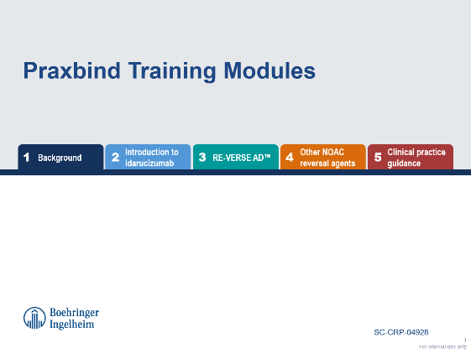
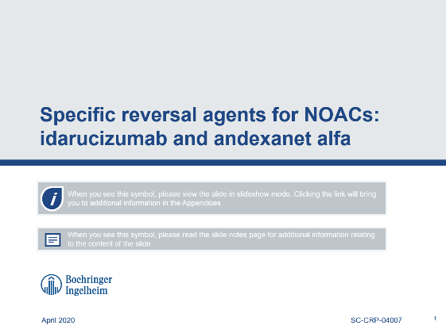
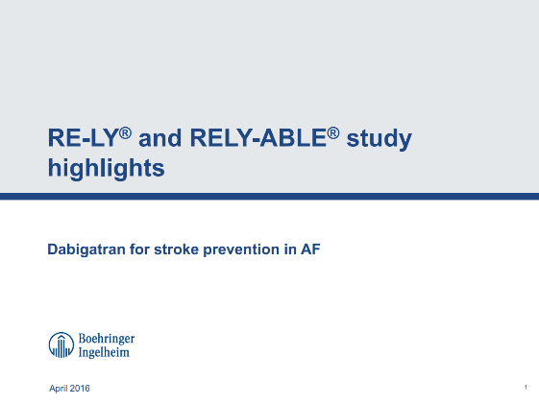
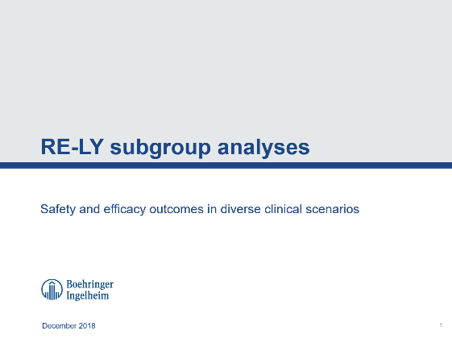
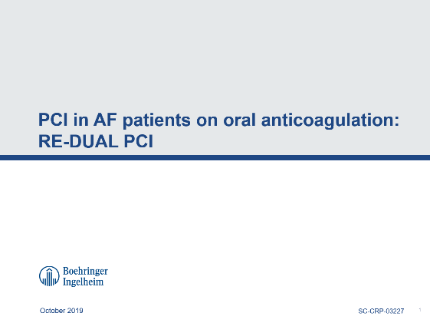
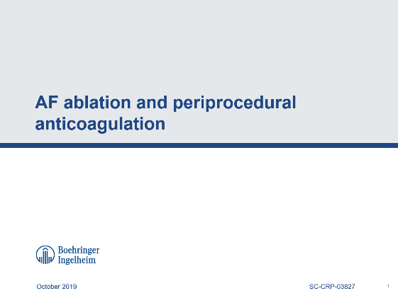

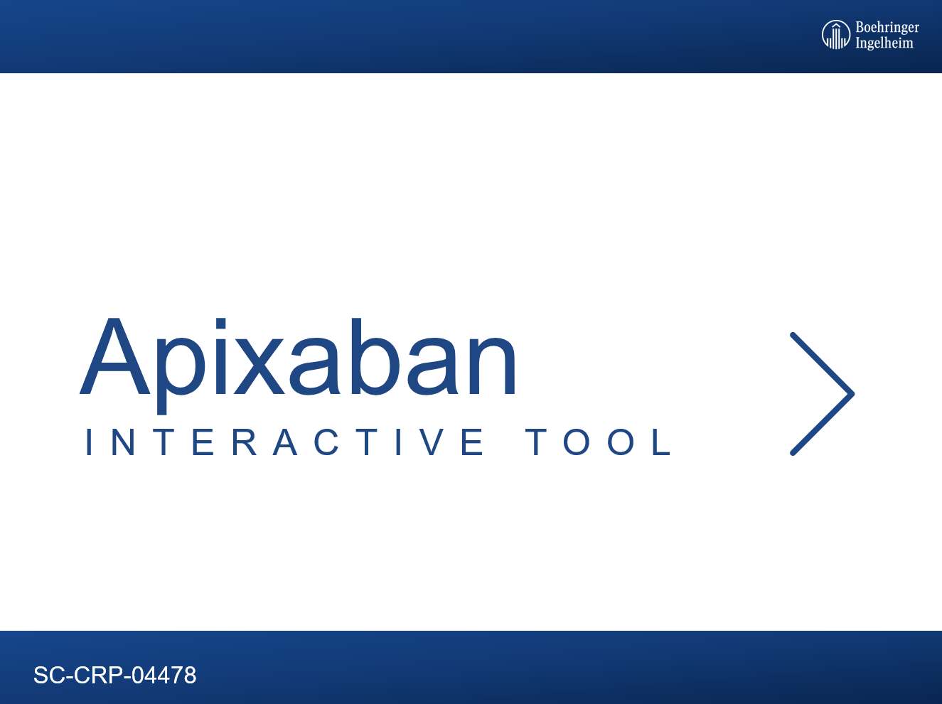
Please see the Boehringer Ingelheim resources below for more information
?
For comprehensive information on AF
and dabigatran RCTs, go to:
?
For comprehensive information on idarucizumab and NOAC reversal, go to:
Specific reversal agents for NOACs: idarucizumab and andexanet alfa MSL deck
(SC-CRP-04007)
Pradaxa Training Modules
(SC-CRP-04814)
Praxbind Training Modules
(SC-CRP-05014)
?
For MSL decks on dabigatran RCTs,
go to:
?
For comprehensive information on dabigatran and other NOACs, go to:
AF ablation and periprocedural anticoagulation MSL deck
(SC-CRP-03827)
Rivaroxaban interactive deck
(SC-CRP-03235)
Dabigatran vs apixaban interactive slide set
(SC-CRP-04478)
RE-LY and RELY-ABLE study highlights MSL deck
(SC-CRP-03394)
RE-LY subgroups MSL deck
(SC-CRP-02912)
RE-DUAL PCI update MSL deck
(SC-CRP-03227)

